Slide 1


Tuan Duong
January 2, 2022

Slide 2


Executive Summary
SpaceY is a new commercial rocket company founded by Billionaire industrialist, Allon Mask, that would like to join the space race.
The main competitor, SpaceX, advertises launch services starting at $62 million versus their competitors services upwards of $165 million dollars.
The reason for this is SpaceX reuses the first stage of rocket launches, saving millions of dollars.
By using past public data from the Space X Falcon 9 launches, SpaceY will determine which parameters are important for successful first stage launches and reusability.
As a result, SpaceY will be able to make more informed bids against SpaceX by using 1st stage landing predictions as the basis for their future launches.

Slide 3

Table of Contents
Executive Summary
Introduction
Methodology
Results
Conclusion
Appendix

Slide 4
Introduction: Background
This project is being presented in the role of a data scientist working for the fictitious new rocket company, SpaceY, that would like to compete with SpaceX founded by Billionaire industrialist Allon Mask.
It was prepared for the IBM Applied Data Science Capstone course.
This report includes the data scientist methodology, results, and conclusions on their findings.

Slide 5

Introduction: Business Problem
SpaceX advertises Falcon 9 rocket launches with a cost of 62 million dollars because they can reuse the first stage of rocket launches.
The first stage is estimated to cost upwards of 15 million dollars to create.
This report aims to accurately predict the likelihood of the first stage rocket landing successfully for reusability.

Slide 6


Slide 7
Methodology
Overview of methodologies used by data scientist
Data Collection
Data Wrangling
Exploratory Data Analysis: Visual Analytics
Exploratory Data Analysis: SQL
Data Visualization: Map
Data Visualization: Dashboard
Predictive Analysis (Classification)
Results

Slide 8
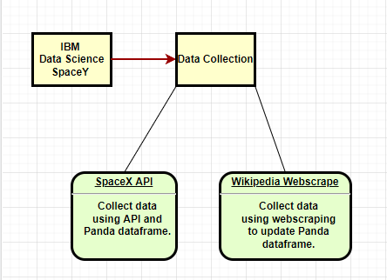
Methodology: Data Collection
Two methods were used to collect data.
Open-Source Rest API: Application programming interfaces was used with request library to get data using SpaceX API.
Web scraping: the process of using beautifulsoup library to extract content and data from a website. The data was collected using the public website, Wikipedia.

Slide 9
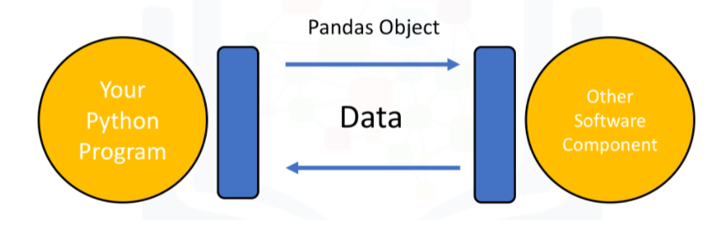
Methodology: Data Collection – SpaceX API
SpaceX API
Gathered historical public data using Open-Source API for SpaceX:
Request and parse the SpaceX launch data using the GET request.
Loaded information with Get Functions and loaded into Panda Dataframe.
Filtered data to only use Falcon 9 launches.
https://github.com/viettwoone/ibm_data_science/blob/main/jupyter-labs-spacex-data-collection-api.ipynb

Slide 10
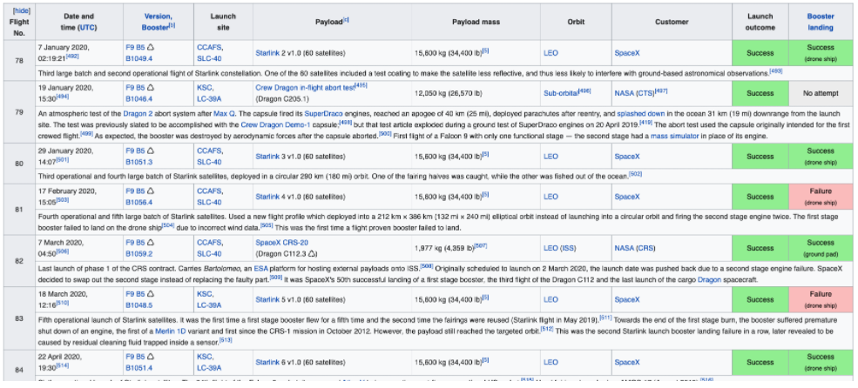
Methodology: Data Collection - Scraping
Webscraping Wikipedia
Webscraping Wikipedia for public knowledge:
Request the Falcon9 Launch Wiki page from its URL.
Extract all column/variable names from the HTML table header.
Create a data frame by parsing the launch HTML tables using Panda’s Dataframe
https://github.com/viettwoone/ibm_data_science/blob/main/jupyter-labs-webscraping.ipynb

Slide 11
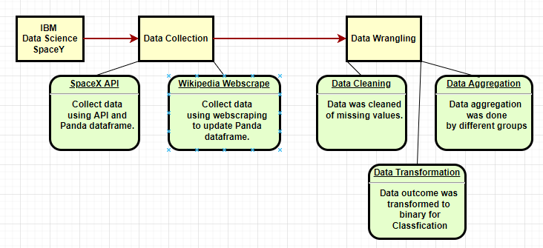
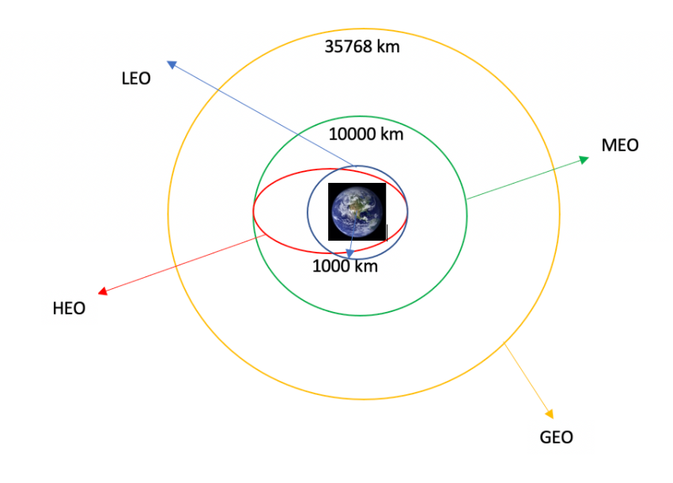
Methodology: Data Wrangling
Data wrangling
The process of cleaning and unifying messy and complex data sets for easy access and analysis.
Data was loaded into Panda’s Dataframe
Identify and calculate the percentage of the missing values in each attribute
Changing missing values and imputing their mean
Identify which columns are numerical and categorical
Calculate the number of launches on each site
Calculate the number and occurrence of each orbit
Calculate the number and occurence of mission outcome per orbit type
Transformed data to binary column, class, where 0 = unsuccessful, 1 = successful
https://github.com/viettwoone/ibm_data_science/blob/main/labs-jupyter-spacex-Data%20wrangling.ipynb

Slide 12
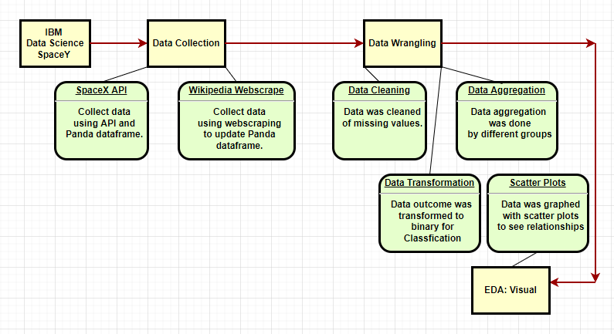
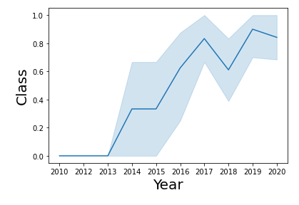
Methodology: EDA with Data Visualization
EDA: Data Visualization
Exploratory data analysis (EDA) is used by data scientists to analyze and investigate data sets and summarize their main characteristics, often employing data visualization methods.
Scatter plots were used to explore the target variable (class) and the different relationships it had with various features.
Bar graphs to see frequency.
Line graphs to see trends.
Features included: payload in weight, launch-site locations, orbit, time, landing pad, block, grid fins, re-used counts, and serials.
https://github.com/viettwoone/ibm_data_science/blob/main/jupyter-labs-eda-dataviz.ipynb

Slide 13
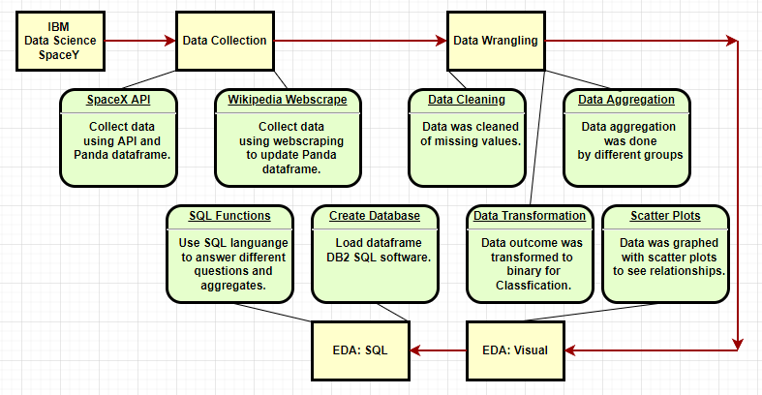
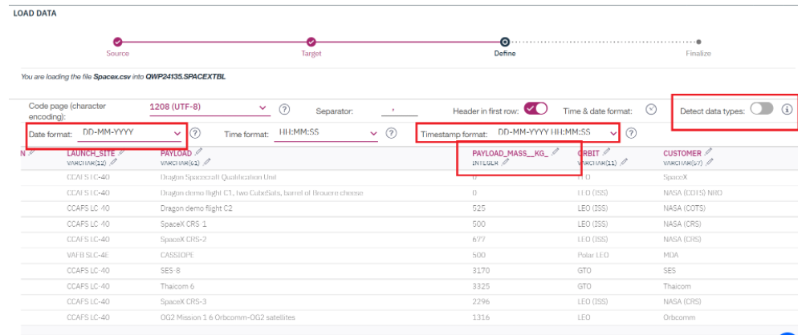
Methodology: EDA with SQL
EDA: SQL
Exploratory data analysis (EDA) is used by data scientists to analyze and investigate data sets and summarize their main characteristics, this time using SQL (Structured Query Language).
Loaded dataframe as a database using DB2
Used SQL to answer questions about features.
Ex1. List the total number of successful and failure mission outcomes
https://github.com/viettwoone/ibm_data_science/blob/main/jupyter-labs-eda-sql-coursera.ipynb

Slide 14
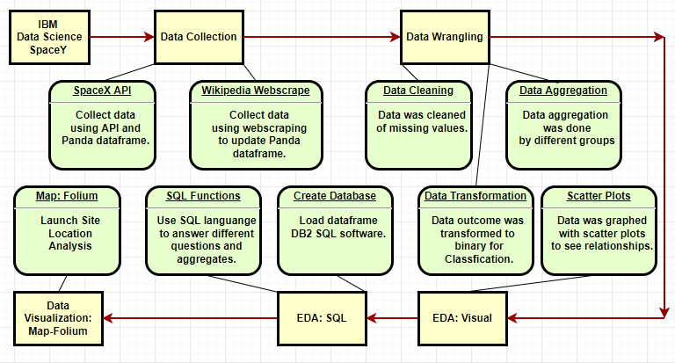
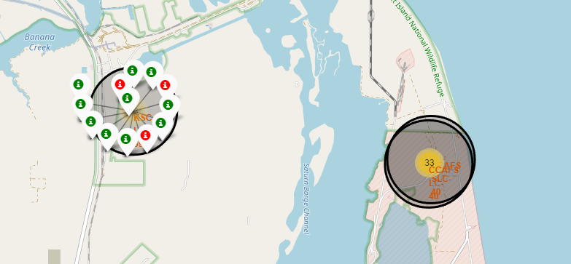
Methodology: Build an Interactive Map with Folium
Data Visualization: Launch Sites Locations Analysis with Folium
Data visualization is the graphical representation of information and data. By using visual elements like charts, graphs, and maps, data visualization tools provide an accessible way to see and understand trends, outliers, and patterns in data.
The data scientist wanted to determine if location was an important feature of target variable.
Visual map is one approach to see success rate of different launch sites and their surroundings.
The data scientist can engage in risk management, transportation, and other location factors.
https://github.com/viettwoone/ibm_data_science/blob/main/lab_jupyter_launch_site_location.ipynb

Slide 15
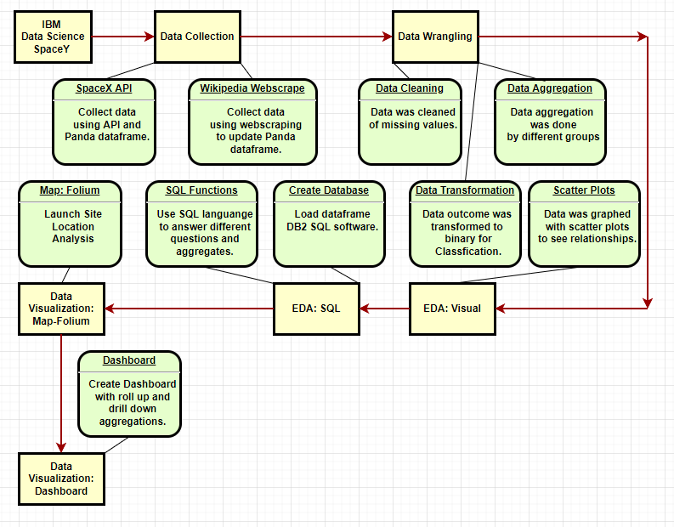
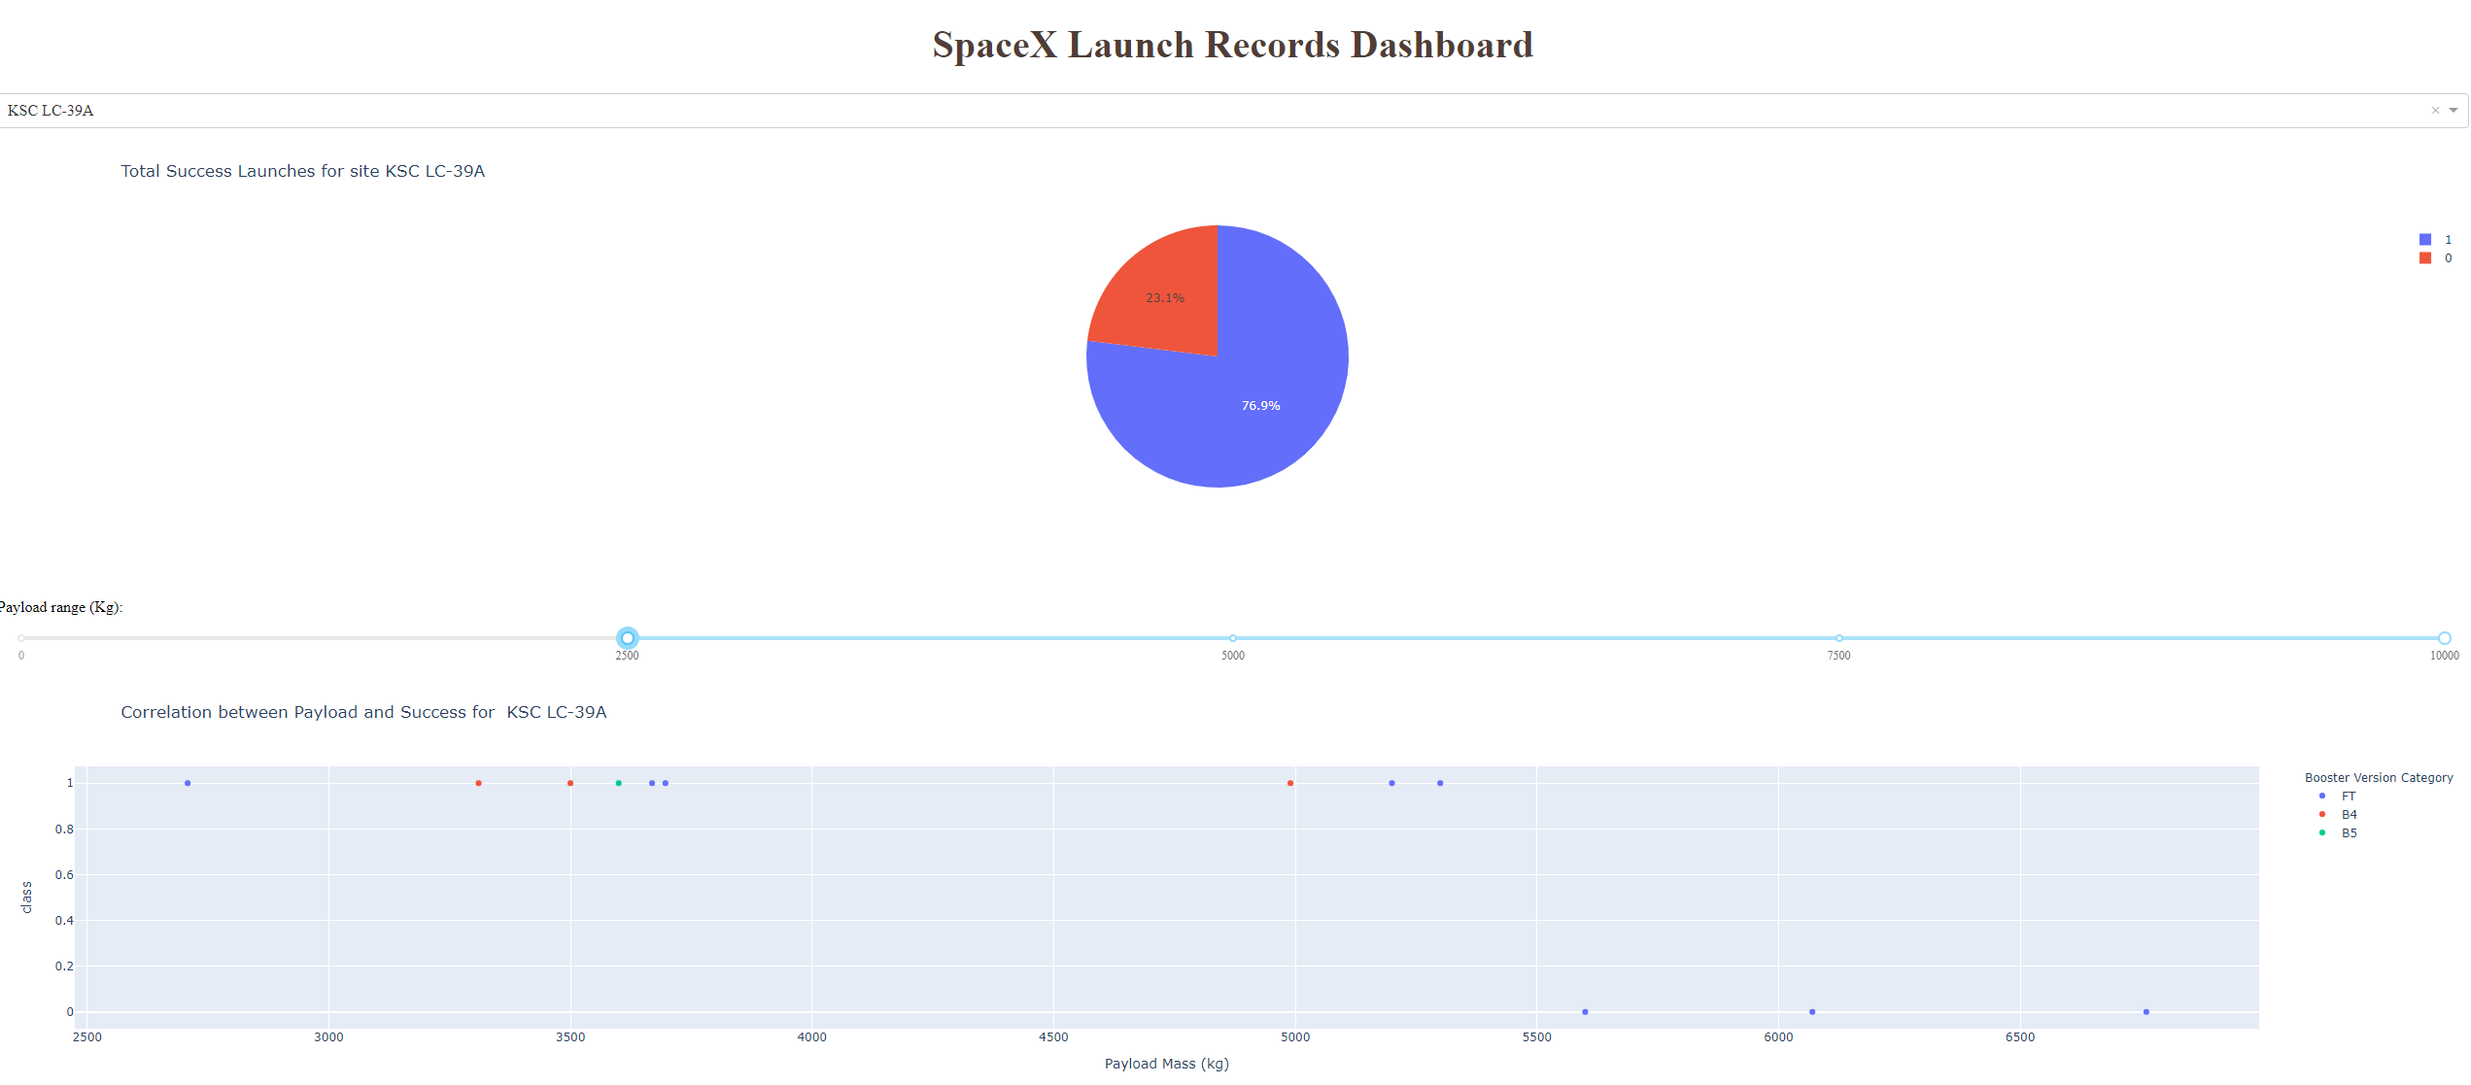
Methodology: Build a Dashboard with Plotly Dash
Data Visualization: Dashboard
A dashboard is a type of graphical user interface which often provides at-a-glance views of key performance indicators (KPIs) relevant to a particular objective or business process.
Dashboard was created to help stakeholders visualize findings through roll up/drill down and different menus to see data at different angles.
Strong features and aggregations were shown with biggest impact on target variable.
https://github.com/viettwoone/ibm_data_science/blob/main/spacex_dash_app.ipynb

Slide 16
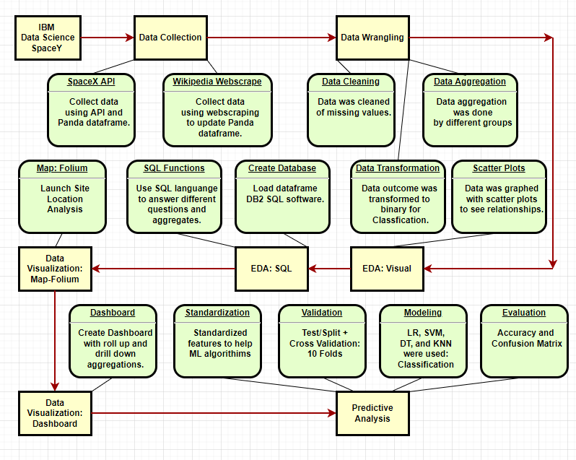
Methodology: Predictive Analysis (Classification)
Predictive analytics: Classification
Use of data, statistical algorithms and machine learning techniques to identify the likelihood of future outcomes based on historical data.
Classification was used since the data scientist used a binary target variable with success rate outcome 0 = unsuccessful and 1 = successful
Standardized features to help ML algorithm train
Train/Test Split and Cross Validation: 10 folds were used to validate the data
Tried 4 different ML methods of logistic regression, sector vector machine, decision tree, and k nearest neighbors
Evaluation methods included accuracy check of classification and confusion matrix
https://github.com/viettwoone/ibm_data_science/blob/main/SpaceX_Machine%20Learning%20Prediction_Part_5.ipynb

Slide 17
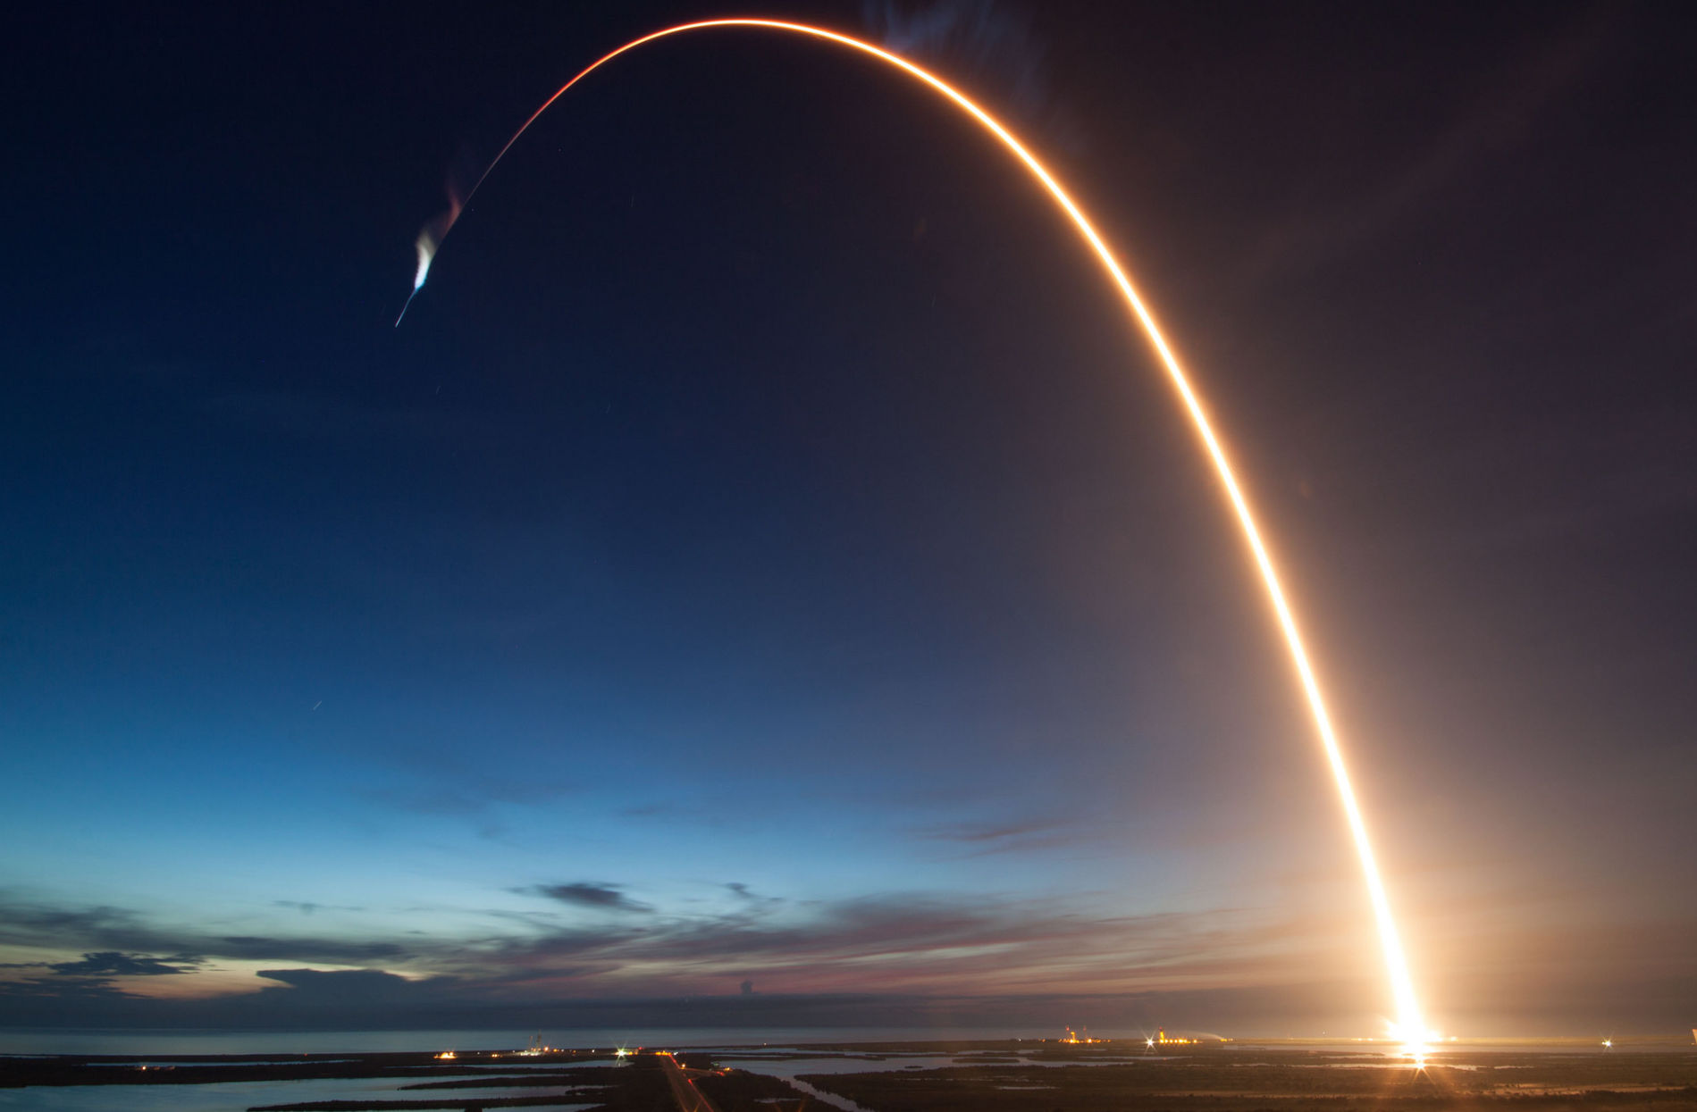
Results
EDA: Visualization Results
EDA: SQL Results
Data Visualization: Map Results
Data Visualization: Dashboard
Predictive Analysis
Evaluation

Slide 18


Slide 19
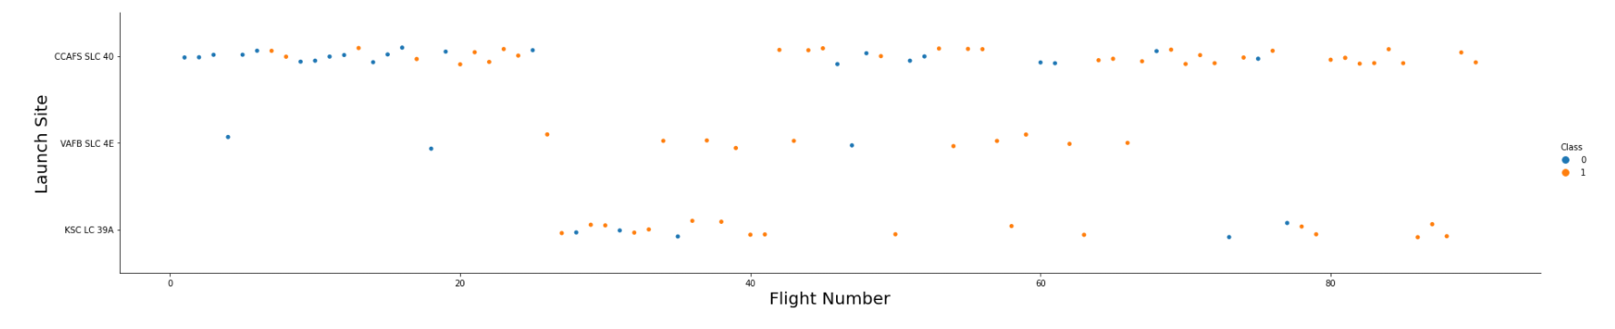
Flight Number vs. Launch Site
The data scientist used an EDA visualization scatter plot graph using Seaborn and Matplotlib, where x = Flight Number and Y = Launch Site.
Blue dots were unsuccessful, orange dots were successful.
Success rate affected by Location feature?
Visually, yes, more orange/blue dot ratio on VAFB and KSC locations. Need further investigation.

Slide 20
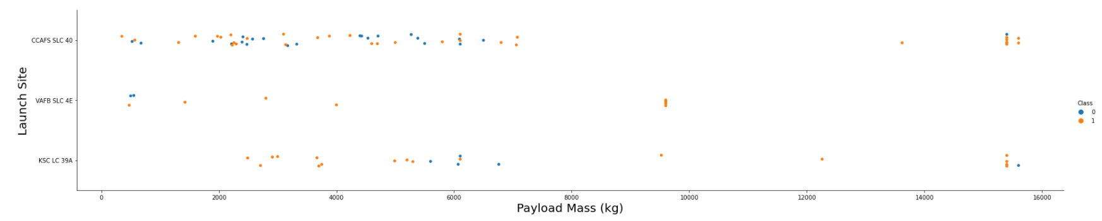
Payload vs. Launch Site
The data scientist used an EDA visualization scatter plot graph using Seaborn and Matplotlib, where x = Payload Mass (kg) and Y = Launch Site.
Blue dots were unsuccessful, orange dots were successful.
Success rate affected by Location/Weight features?
Visually, yes, more orange/blue dot ratio on VAFB and KSC locations. Need further investigation.

Slide 21
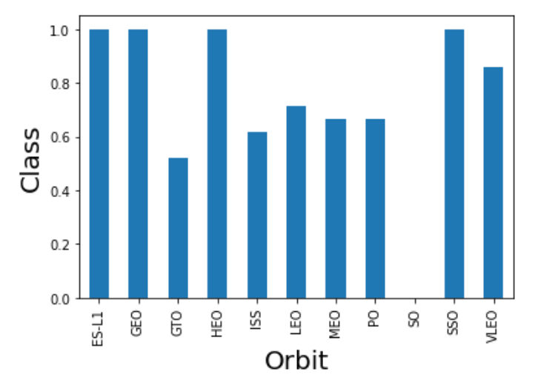
Success Rate vs. Orbit Type
The data scientist used an EDA visualization bar graph using Seaborn and Matplotlib, where x = Orbit and Y = Success Rate.
Success rate affected by Orbit feature?
Visually, not enough information. Not enough samples on some categories.

Slide 22
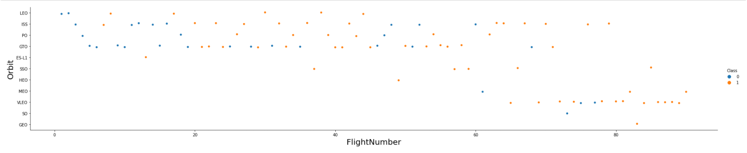
Flight Number vs. Orbit Type
The data scientist used an EDA visualization scatter plot graph using Seaborn and Matplotlib, where x = Flight Number and Y = Orbit.
Blue dots were unsuccessful, orange dots were successful.
Success rate affected by Orbit feature?
Visually, not enough information. Not enough samples on some categories.

Slide 23
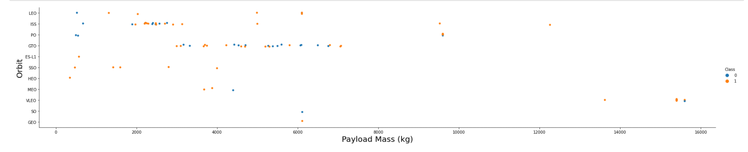
Payload vs. Orbit Type
The data scientist used an EDA visualization scatter plot graph using Seaborn and Matplotlib, where x = Payload Mass (kg) and Y = Orbit.
Blue dots were unsuccessful, orange dots were successful.
Success rate affected by Weight/Orbit features?
Visually, not enough information. Not enough samples on some categories.

Slide 24
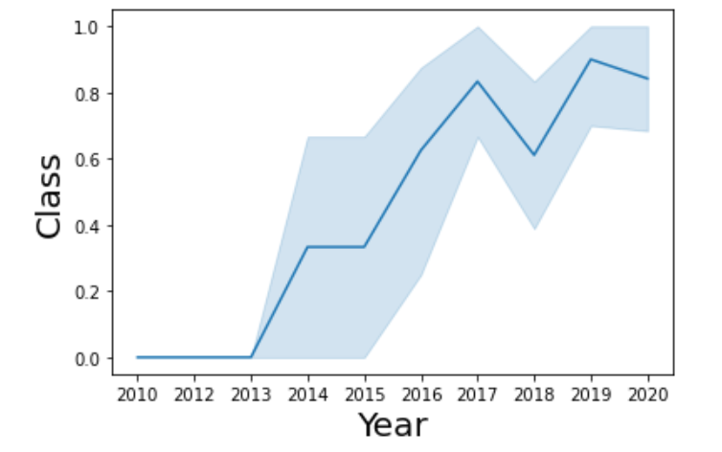
Launch Success Yearly Trend
The data scientist used an EDA visualization line graph using Seaborn and Matplotlib, where x = Time and Y = Success Rate.
Success rate affected by Time feature?
Visually, definite yes, but still need further investigation.

Slide 25
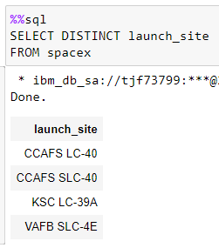
All Launch Site Names
The data scientist used an EDA SQL Database and SQL query to answer the following question:
Display the names of the unique launch sites in the space mission?
Answer:
CCAFS LC-40
CCAFS SLC-40
KSC LC-39A
VAFB SLC-4E

Slide 26
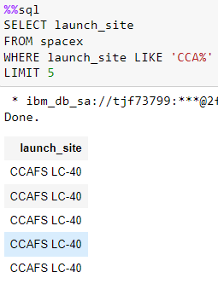
Launch Site Names Begin with 'CCA'
The data scientist used an EDA SQL Database and SQL query to answer the following question:
Display 5 records where launch sites begin with the string 'CCA'
Answer:
CCAFS LC-40

Slide 27
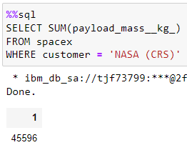
Total Payload Mass
The data scientist used an EDA SQL Database and SQL query to answer the following question:
Display the total payload mass carried by boosters launched by NASA (CRS)
Answer:
45596

Slide 28
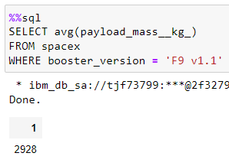
Average Payload Mass by F9 v1.1
The data scientist used an EDA SQL Database and SQL query to answer the following question:
Display average payload mass carried by booster version F9 v1.1
Answer:
2928

Slide 29
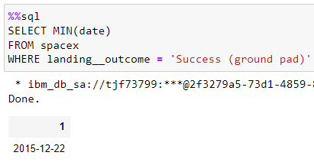
First Successful Ground Landing Date
The data scientist used an EDA SQL Database and SQL query to answer the following question:
List the date when the first successful landing outcome in ground pad was achieved.
Answer:
12/22/2015

Slide 30
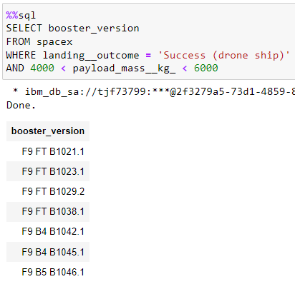
Successful Drone Ship Landing with Payload between 4000 and 6000
The data scientist used an EDA SQL Database and SQL query to answer the following question:
List the names of the boosters which have success in drone ship and have payload mass greater than 4000 but less than 6000
Answer:
F9 FT B1021.1
F9 FT B1023.1
F9 FT B1029.2
F9 FT B1038.1
F9 B4 B1042.1
F9 B4 B1045.1
F9 B4 B1046.1

Slide 31
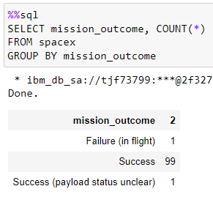
Total Number of Successful and Failure Mission Outcomes
The data scientist used an EDA SQL Database and SQL query to answer the following question:
List the total number of successful and failure mission outcomes
Answer:
Failure: 1
Success: 99
Unclear: 1

Slide 32
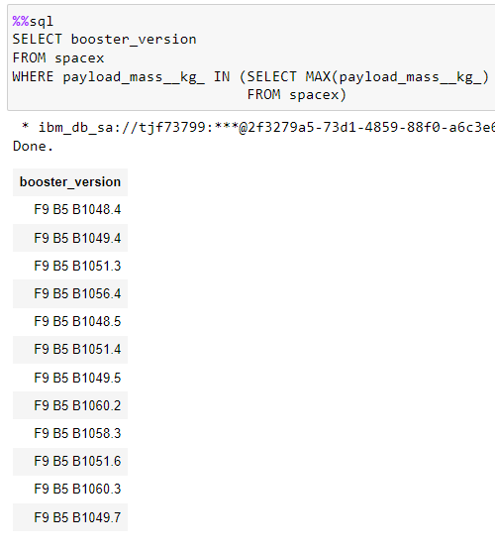
Boosters Carried Maximum Payload
The data scientist used an EDA SQL Database and SQL query to answer the following question:
List the names of the booster_versions which have carried the maximum payload mass. Use a subquery
Answer:
F9 FT B1048.4
F9 FT B1048.4
F9 FT B1051.3
F9 FT B1056.4
F9 FT B1048.5
F9 FT B1051.4
F9 FT B1049.5
F9 FT B1060.2
F9 FT B1058.3
F9 FT B1051.6
F9 FT B1060.3
F9 FT B1049.7

Slide 33
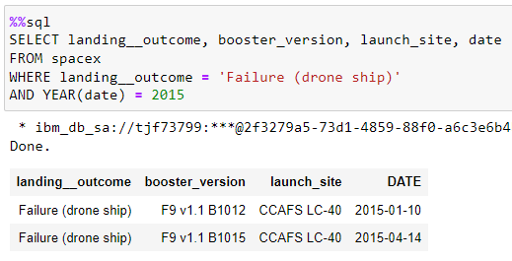
2015 Launch Records
The data scientist used an EDA SQL Database and SQL query to answer the following question:
List the failed landing_outcomes in drone ship, their booster versions, and launch site names for in year 2015
Answer:
Failure (drone ship) F9 v1.1 B1012 CCAFS LC-40 2015-01-10
Failure (drone ship) F9 v1.1 B1015 CCAFS LC-40 2015-04-14

Slide 34
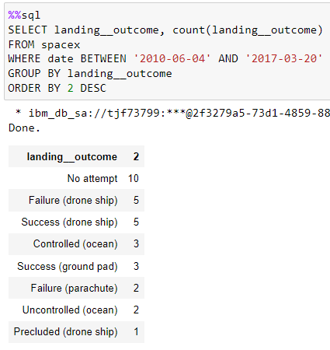
Rank Landing Outcomes Between 2010-06-04 and 2017-03-20
The data scientist used an EDA SQL Database and SQL query to answer the following question:
Rank the count of landing outcomes (such as Failure (drone ship) or Success (ground pad)) between the date 2010-06-04 and 2017-03-20, in descending order
Answer:
No attempt 10
Failure (drone ship) 5
Success (drone ship) 5
Controlled (ocean) 3
Success (ground pad) 3
Failure (parachute) 2
Uncontrolled (ocean) 2
Precluded (drone ship) 1

Slide 35


Slide 36
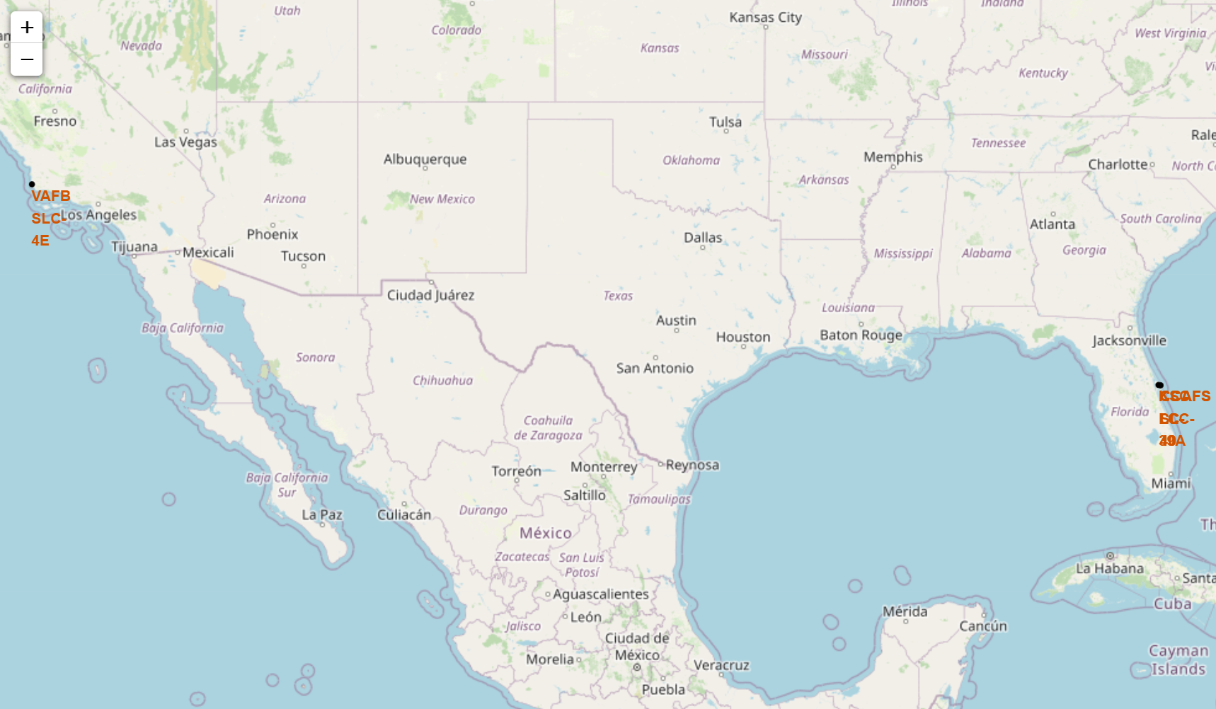
All Launch Sites
This map was produced by using the panda library: folium and inputting the data location through the data frame.
The importance of data visualization is to help the data scientist understand if location has any effect on successful launches and their risks.
This map shows all the locations of the launches.

Slide 37
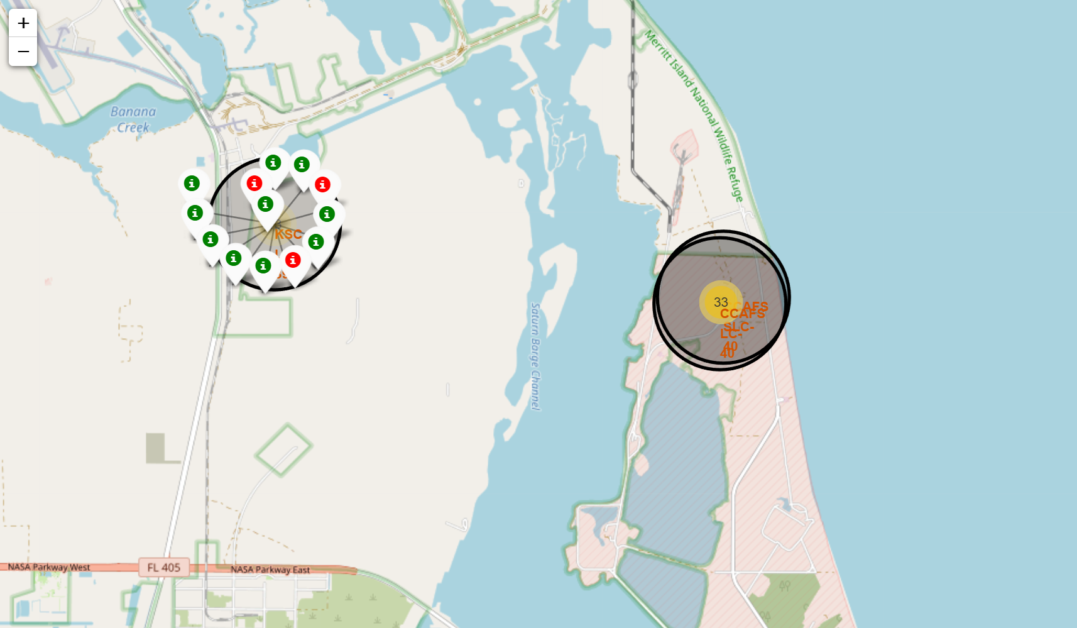
Success Rate by Launch-Site
This map was produced by using the panda library of folium and inputting the data location through the data frame.
The importance of data visualization is to help the data scientist understand if location has any effect on successful launches and their risks.
This map shows the success/failed launches of each site by clicking on any circled marker, green means success and red means failure.

Slide 38
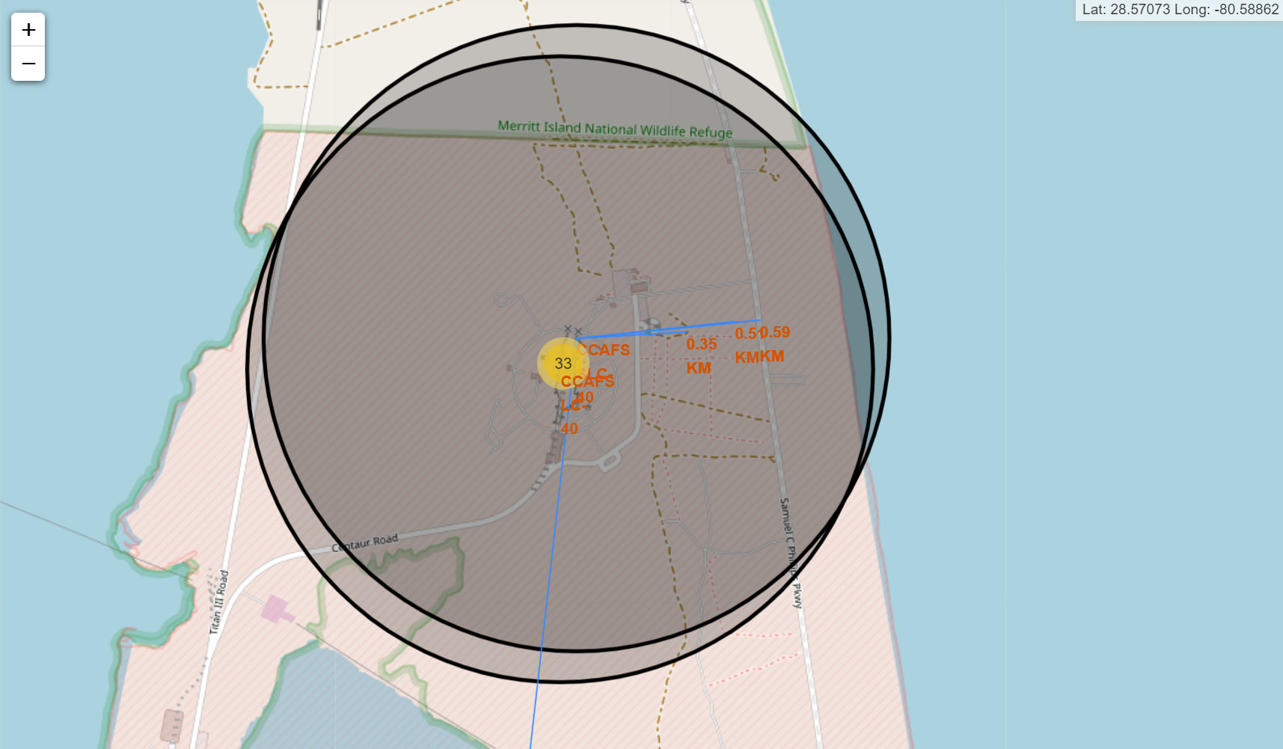
Nearest Risks/Transportation
This map was produced by using the panda library of folium and inputting the data location through the data frame.
The importance of data visualization is to help the data scientist understand if location has any effect on successful launches and their risks.
This map shows the nearest railroads, highways, and cities to determine the risks and modes of transportations from CCAFS LC 40 launch site.
Nearest Railroad = 0.35130446057664205 km
Nearest Highway = 0.5890306859613954 km
Nearest City = 25.065251129546912 km

Slide 39


Slide 40
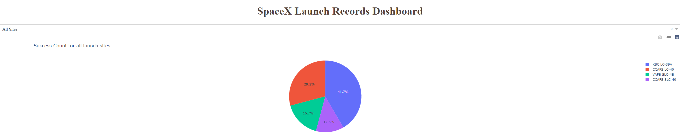
Successful Launches
All Sites
The data scientist made this dashboard using dash and plotly libraries.
The following Pie Chart represents all of the successful launches through the 4 sites.
Descending Order
KSC LC-39A: 41.7%
CCAFS LC-40: 29.2%
VAFB SLC-4E: 16.7%
CCAFS SLC-40: 12.5%

Slide 41
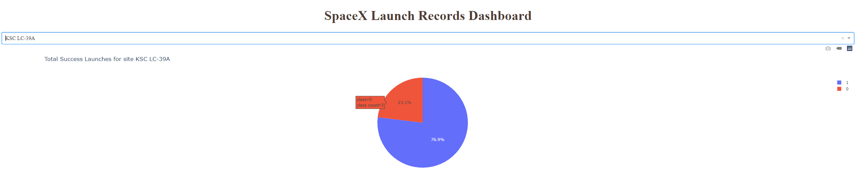
KSC LC-39A Pie Chart
The data scientist made this dashboard using dash and plotly libraries.
The following Pie Chart represents the launch site with the highest success ratio.
KSC LC-39A had 3 failed launches and 10 successful launches.
KSC LC-39A had the highest success rate of 10/13 = 76.9%.

Slide 42
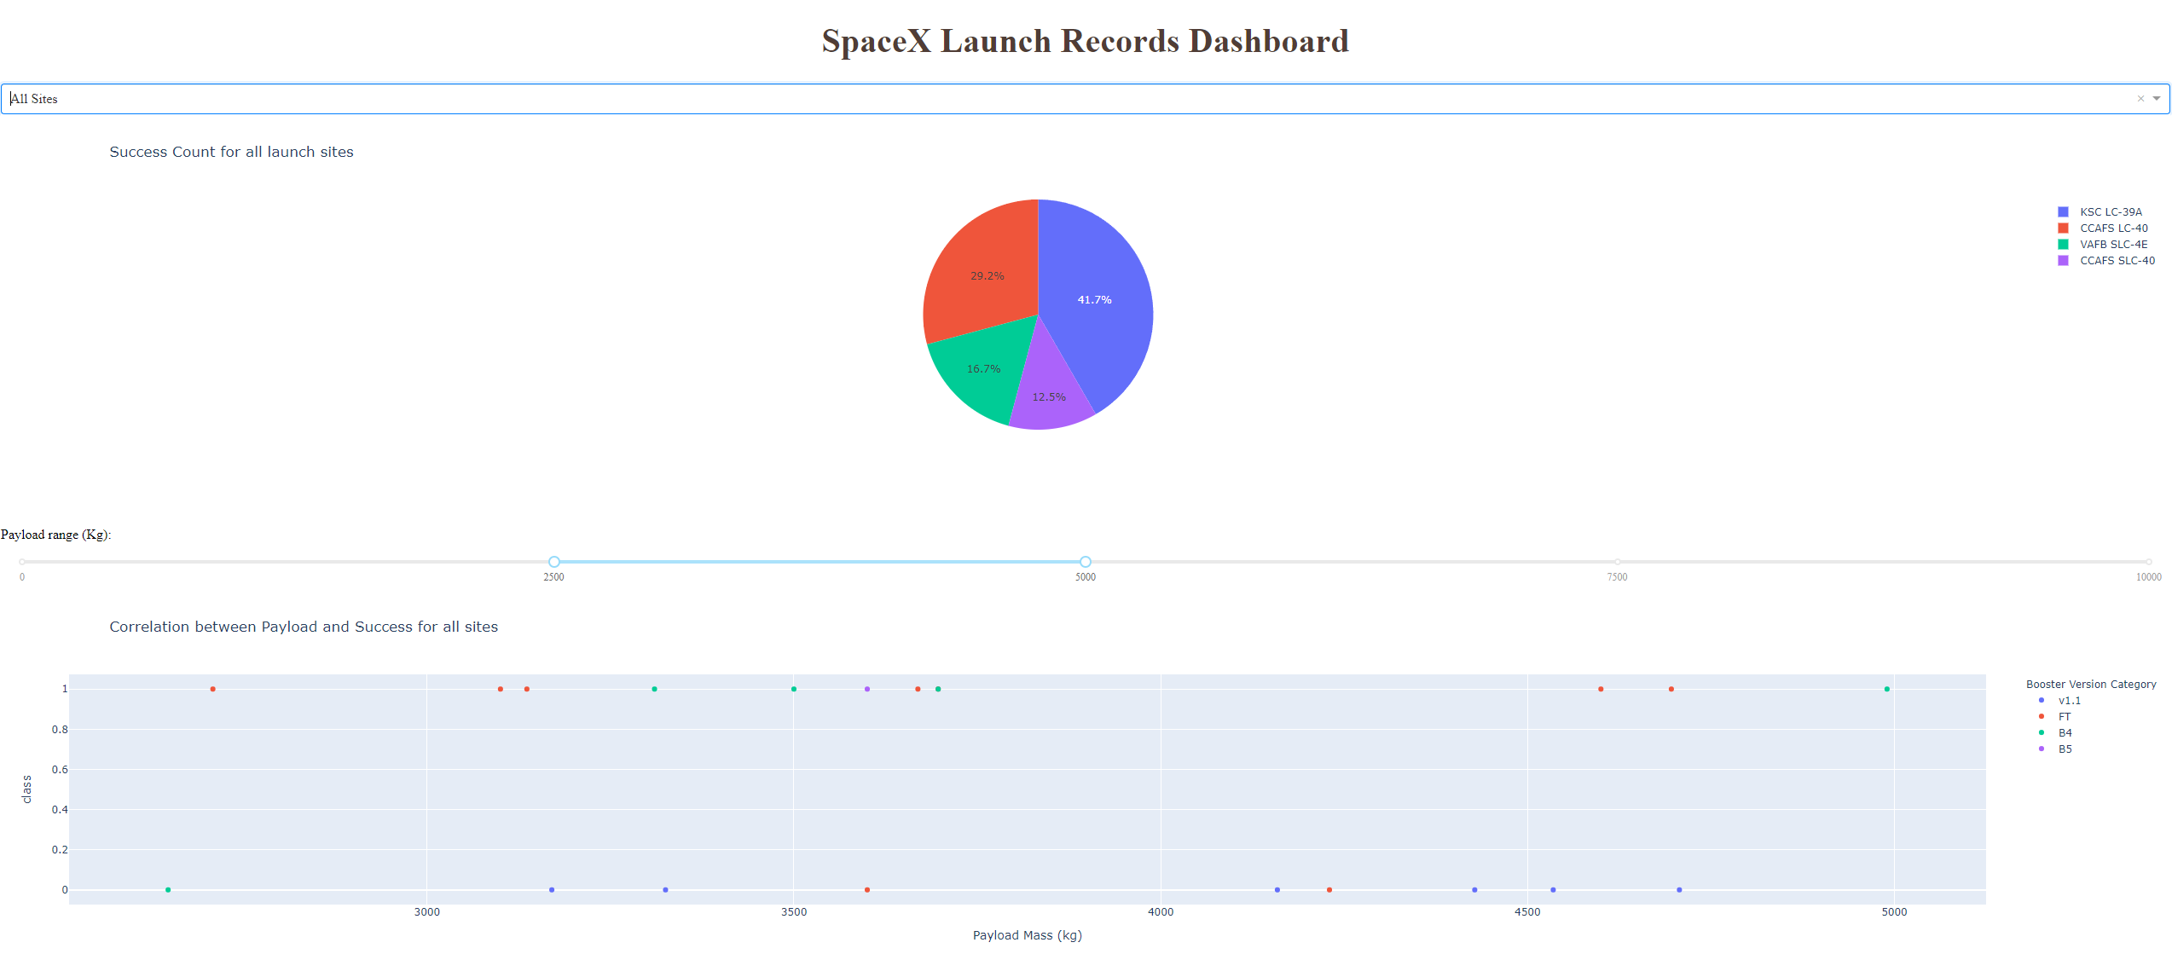
All Sites, 2500-5000 Payload + FT Booster
The data scientist made this dashboard using dash and plotly libraries.
The following Line Chart represents the launch site with the highest success ratio with payloads and boosters.
The following success rate of payload are as follows:
0 – 2500 Success/Failure 7/12 36%
2500-5000 Success/Failure 11/9 55%
5000-7500 Success/Failure 2/7 22%
7500-10000 Success/Failure 1/1 50%
The most successful booster within the payload range of 2500-5000 is the FT booster.

Slide 43


Slide 44
Classification Accuracy
The following bar chart represents the accuracy of all 4 Machine Learning algorithms used for classification.
K Nearest Neighbors, Decision Tree, Sector Vector Machine, and Log Regression.
All of them have the same accuracy rating of 83.3%.

Slide 45
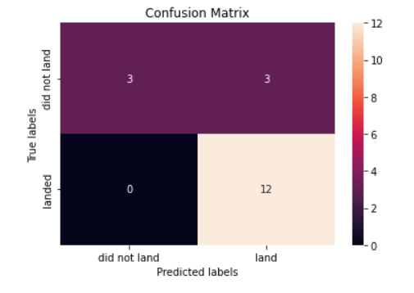
Confusion Matrix
4 confusion matrices were used for each classification machine learning method, with all 4 methods having the same end-product.
The matrix shows that there were 12 true positives, 3 false positives, 0 false negatives, and 3 true negatives.
This means all 4 ML methods had 83.3% accurate at classifying each event besides false positives.

Slide 46
Conclusions
Classification models from this report will help SpaceY predict successful 1st stage landings with 83.3% accuracy.
SpaceX indicates the 1st stage booster costs upwards of $15 million to build.
Statistically, these findings can help SpaceY attribute each launch to $2.5 million with this accuracy. (15 * .167 = ~2.5)
Understanding the data with the best parameters will also increase the success rate.
Some of the findings suggest the organization can optimize: launch sites, weight, booster, etc.
This data and models should be iterative and can be further approved with every launch.

Slide 47
Appendix & Acknowledgements
Appendix
The following links were produced on Juypter Notebooks using Python code and libraries. These libraries include: Panda, Numpy, Matplotlib, Seaborn, Dash, Request, Beautifulsoup, API, Ski-Learn, SQL, DB2, SqlAlchemy, IBM, Ipython, Datetime, Folium, and Wget.
https://github.com/viettwoone/ibm_data_science/blob/main/SpaceX_Machine%20Learning%20Prediction_Part_5.ipynb
https://github.com/viettwoone/ibm_data_science/blob/main/jupyter-labs-eda-dataviz.ipynb
https://github.com/viettwoone/ibm_data_science/blob/main/jupyter-labs-eda-sql-coursera.ipynb
https://github.com/viettwoone/ibm_data_science/blob/main/jupyter-labs-spacex-data-collection-api.ipynb
https://github.com/viettwoone/ibm_data_science/blob/main/jupyter-labs-webscraping.ipynb
https://github.com/viettwoone/ibm_data_science/blob/main/lab_jupyter_launch_site_location.ipynb
https://github.com/viettwoone/ibm_data_science/blob/main/labs-jupyter-spacex-Data%20wrangling.ipynb
https://github.com/viettwoone/ibm_data_science/blob/main/spacex_dash_app.ipynb
Acknowledgements
Thank you for the IBM team for writing this awesome course.

Slide 48


